Slide 1
Notes
Check with captains about when AP exams are and the track banquet to avoid scheduling conflicts
Ask Captains to join the parent meeting
Haverford High School Girls Track & Field
Spring 2020

Slide 2
Cross Country 2022
HAVERFORD
Use the first few minutes to fill out the Interest Form linked at Linktr.ee/haverfordxctf OR scan the above QR code.
Download the TeamReach App on your phone and enter the group Code: GoFords22
Follow @haverfordxctf on Instagram!
Notes:
https://docs.google.com/forms/d/e/1FAIpQLSe_NIDxpBarEgI6npPVGKjUNhVfPcCinN4KX9Qu5KPRjju-HA/viewform?usp=sf_link

Slide 3
Cross Country 2022
HAVERFORD
Parent/Guardian Meeting
Download the TeamReach App on your phone and enter the group code: GoFords22
Go to Linktr.ee/haverfordxctf (or scan QR code) for various links we’ll discuss
Follow @haverfordxctf on Instagram!
If you’re not already receiving emails, email: mwells@haverfordsd.net Include: Name of student athlete, email addresses & phone numbers for everyone (include who they belong to)

Slide 4
About Cross Country
Race 5 kilometers (3.1 miles)
Everyone competes in 3 Central League meets, 2 invitationals, 2 Championship meets (JV & 7 Varsity)
Top 21 also race at Districts, top 7 also at States
We meet M-F (+ Sat for District hopefuls) by the steps to the track
Haverford High School Girls Track & Field
Spring 2020

Slide 5
Your Coaches & Captains
Coach Laura Clinton
Coach Matt Wells
Coach Elizabeth Clinton
Introducing: Coach Ryan Comstock!
Remy DuFresne
Emily Kunigus
Patrick Lawson
Kelly Murray
Lindsay Orner
Quentin Ryan
Liv Thompson
Gabe Zwilling
Haverford High School Girls Track & Field
Spring 2020

Slide 6
HXC Culture & Values
An open and affirming community that builds a lifelong love of running and friendship.
We consistently work hard & strive to improve
We are One Team always
We always demonstrate good sportsmanship
We have positive attitudes & have fun
Haverford High School Girls Track & Field
Spring 2020

Slide 7
2021 Achievements
The Premier Boys and Girls Combined Program in the Central League
Girls won the Central League Sportsmanship Award
Boys 1st and Girls 2nd in Central League & Delco
11 All-Central AND All-Delco athletes
Girls 3rd, Boys 5th at Districts with 4 medalists
First time in school history that both teams qualified for States in the same year
Boys 5th, Girls 9th in the State with 2 medalists
Girls & Boys JV teams were undefeated & District Champs
Haverford High School Girls Track & Field
Spring 2020

Slide 8
Team Goals
We are a varsity team that always strives for:
Sportsmanship Award
1st place in the Central League
Top 6 in the the District
Top 10 in the State
AND we welcome runners at all levels who are committed to our culture & values.
Haverford High School Girls Track & Field
Spring 2020

Slide 9
Team Expectations
Follow the HXC Contract (letter-earning)
Sportsmanlike conduct
Attendance Policy
Show up every day ready to work hard and put in your best effort
Respect your teammates, your competitors, your coaches, and yourself!
Haverford High School Girls Track & Field
Spring 2020

Slide 10
2022 Season Overview
Jun. 13: Summer Training Starts
Aug. 15: Preseason Starts
Aug. 21: Car Wash #2
Sep. 10: First Meet- Unionville 2 Mile Bash
Sep. 14-30: Three League Meets and 2 Invitationals (1 each JV/V)
Sep. 18: Philly Distance Run Water Station(s)
Oct. 8-15: Central League & Delco Championships
Oct. 28 & 30: Varsity & JV District Championships
Nov. 5: States (Varsity)
Nov. 16: Team Banquet
Haverford High School Girls Track & Field
Spring 2020
+ Pasta parties, bake-offs, and more! Full schedule posted on Linktr.ee/haverfordxctf

Slide 11
2022 Goals
Take out your Chromebooks and go to Linktr.ee/haverfordxctf
Download the Goals Sheet, take a few minutes to complete it, and email/share it with all 4 coaches (Wells, L. Clinton, E. Clinton, Comstock)
*Returning runners can reference your past times on the XC Season Summary/Results spreadsheet
Haverford High School Girls Track & Field
Spring 2020

Slide 12
2022 Summer Training
Rest Period (Now until June 13th)
Google Calendar Workouts & Weekly Emails
Coach-led practice & Captain communication
Summer Gold Standard & logging mileage
Equipment (shoes & watch)
TeamReach App (Code: GoFords22) & Strava
Haverford High School Girls Track & Field
Spring 2020
Notes:
Rest Period:
1 week completely off of running
1 week of running because you love it but at low mileage
Summer Gold Standard:
Log at least 50 days of training
Pay dues for the shirt

Slide 13
2022 Preseason
Starts August 15th, 7am at Haverford College
MANDATORY ATTENDANCE for all runners
REQUIRED on the first day of preseason:
HHS Forms (including FULL physical dated after June 1) submitted through FamilyID.com
HXC Contract and Goals
Dues
Appropriate equipment (shoes, watch, water)
Haverford High School Girls Track & Field
Spring 2020
Notes:
REQUIRED FORMS:
-ALL PAGES of PIAA Physical
-Assumption of Risk
-Student Eligibility Form
-Impact Permission Form
-Student Contract
-XC Contract
Pay what you want:
$25 for banquet
$15 for shirt
$10 for summer shirt (if you earned it)
$10 for random food
$5 for sunshine fund
TOTAL: max $65
(All extra money goes into savings.)
Physicals dated after June 1st

Slide 14
2022 Dues
Pay what you want:
$25 for banquet
$15 for team shirt
$10 for summer training shirt (if you earned it)
$10 for random food throughout the season
$5 for sunshine fund
TOTAL: max $65
(All extra money goes into savings.)
Haverford High School Girls Track & Field
Spring 2020
Notes:
**if you have amount of this is an issue, let your coaches know.

Slide 15
Summer Vacations
**Schedule vacations before preseason.**
If this is not possible:
A parent/guardian note is required to excuse absences
If athlete can provide proof of workouts identical to those completed by the team, only ½ of the days missed will count as absences
If athlete does not complete the workouts, all of the days missed will count as absences
Preseason attendance contributes to an athlete’s consideration for end-of-season letters, Districts Team, future Captain positions, etc.
Haverford High School Girls Track & Field
Spring 2020

Slide 16
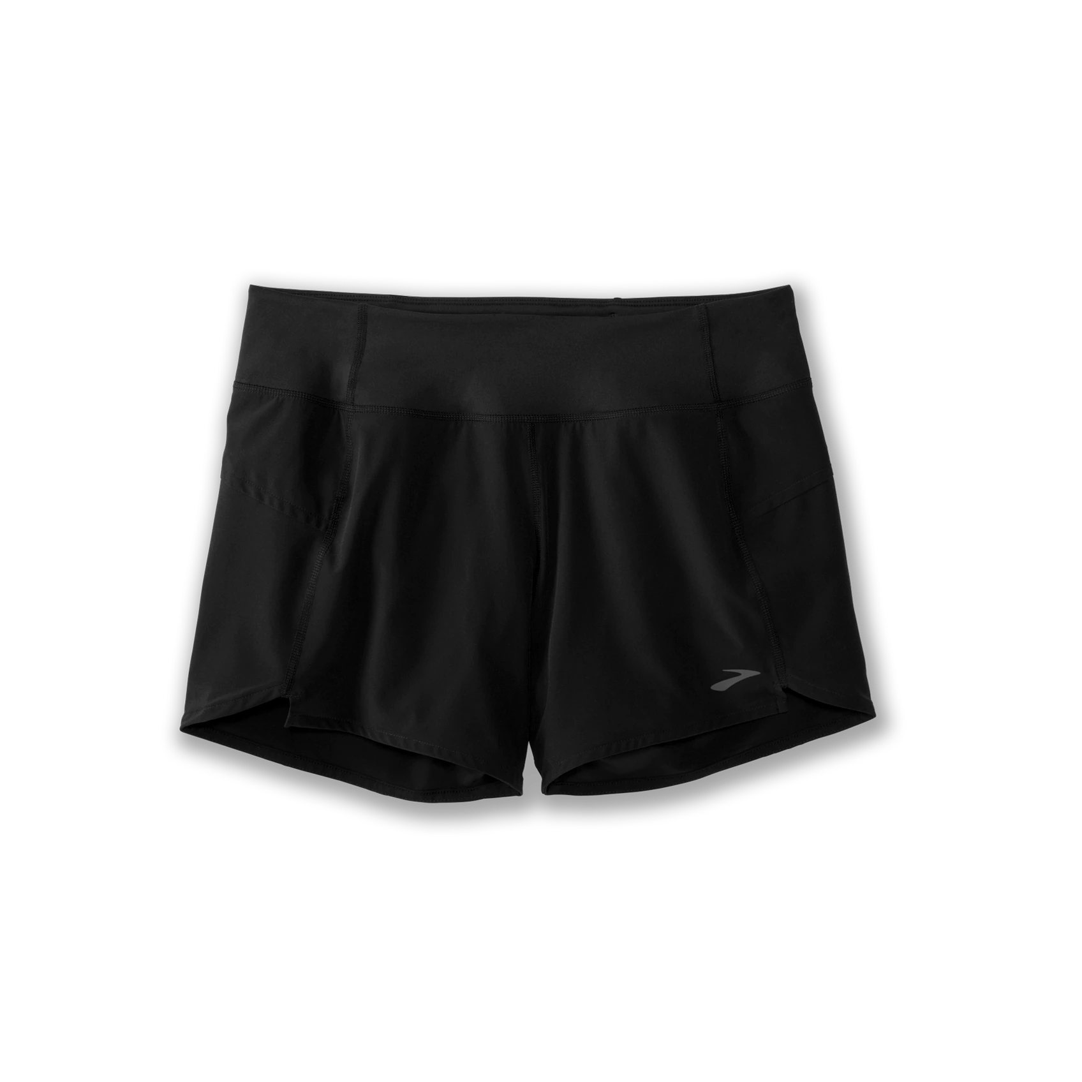
Clothing/Uniform Order
*Closes June 18th https://cmsportinggoods.chipply.com/HavXC
Needed but not on C&M:
Haverford High School Girls Track & Field
Spring 2020
Notes:
Also on LinkTree

Slide 17
Parent/Guardian Support
Sunday night pasta parties, Food parties after meets, Senior Night, photography, fundraisers, team sleepovers…
Select “Parent/Guardian Sign-Up Sheet” on the LinkTree to sign-up to help out with the activities that make HXC so special!
Haverford High School Girls Track & Field
Spring 2020
Notes:
Parent Sign-Up sheet
https://docs.google.com/spreadsheets/d/1ZlhZheMNcWJ4vvsEVM_Nac0ivxbbY67cXz4-lRpages/edit?usp=sharing

Slide 18
Next Important Dates
TODAY- Schedule your physical, register on FamilyID.com, download TeamReach & Strava
June 13- Summer training starts; have your shoes & watch ready!
June 18- Uniform & team gear order closes
August 15- First day of preseason; ALL forms needed via FamilyID
Haverford High School Girls Track & Field
Spring 2020

Slide 19
Open Door Policy
mwells@haverfordsd.net
lclinton@haverfordsd.net
eclinton@haverfordsd.net
coachcomstock@gmail.com
Haverford High School Girls Track & Field
Spring 2020

Slide 20
Questions or Concerns?
For those whose goal is to make the Districts Team this year (top 21), please stay in the meeting for a few minutes after.
Follow @haverfordxctf on Instagram!

Slide 21
Summer Training Expectations
ASPIRING DISTRICTS TEAM
Rest
Logging training
Intentional training every day
The Little Things (strides, drills, SAM, strength, equipment, hydrating, sleep, healthy fueling)
Encouraging others & being leaders
*Blood testing

